Slide 1
Taum Sauk Dam Failure Missouri, 2005
Ryan Budd Bryan Priebe Kelsey Watkins

Slide 2
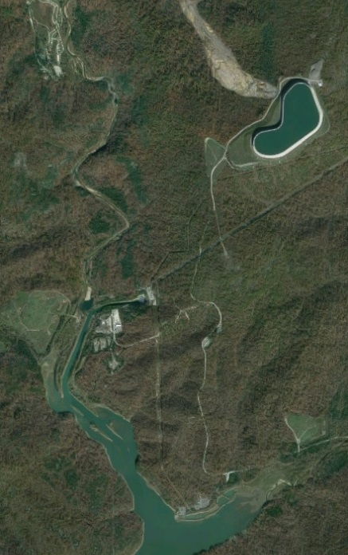
History
Located near the black river in Reynolds County, Missouri, approximately 90 miles southwest of St. Louis, Missouri.
Completed in the 1960’s, the project was built to produce hydroelectric power. During peak hours water flows through a 7,000 foot pipe to a reservoir downstream. The elevation drop is 800 feet.
Less expensive electricity, due to low demand hours, is used to pump the water back up the mountain to the upper reservoir.

Slide 3
As built section

Slide 4
False sense of security
A new geomembrane was installed in 2004 that significantly reduced the historical leakage, which likely increased the chance of overtopping of the parapet walls

Slide 5
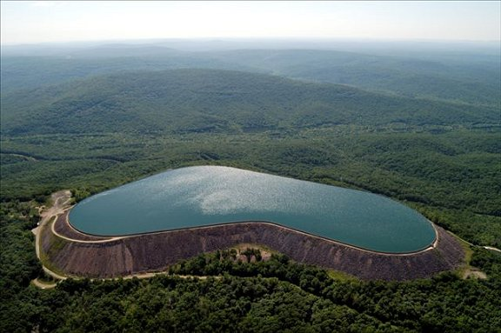
Overflow Warning
The day before the Taum Sauk Project was to be given an Institute of Electrical and Electronics Engineers (IEEE) Award for innovation, Amerenue (formerly United Electric) representatives went on site to look at the reservoir. They noticed a portion of the reservoir spilling over the edge, and pumps were manually shut down. As much as 2 feet of settlement had occurred around the walls of the reservoir which caused the spill.

Slide 6
Further Problems
As much as the settlement was a problem, when divers investigated the possible cause of the overflow, they determined that several of the HDPE transducer-housing conduits had become detached from their original and intended positions. As a result, the pressure transducers’ ability to report accurate water levels was hindered, and lower water levels were being recorded than actually existed.

Slide 7
Dam Failure
4,300 acre-feet in approximately 25 minutes, with a peak discharge of 273,000 cubic feet per second (cfs). Estimates calculate approximately 31 acre-feet of overtopping occurred for 21 minutes (1,070 cfs) before failure.

Slide 8
Poor foundation
“fish pond” from over-excavation during original construction due to poor foundation conditions

Slide 9
Poor foundation
Weathered rock and discontinuous clay seam just below breach

Slide 10
Erosion from overtopping

Slide 11
Scour after dam failure

Slide 12
Stability analysis using utexas4
Stability analysis were done using three ranges of shear strengths for the various materials present in the breach:
Bedrock
Weathered rock/clay
Road fill
Rock fill
Reinforced concrete

Slide 13
Highest factor of safety

Slide 14
Lowest factor of safety

Slide 15
Static stability (no overtopping erosion)

Slide 16
Present day rcc dam

